Slide 1
Accessibility Testing Approach
Make differently abled to digitally enabled
Part 2 of 2

Slide 2
Agenda
What is Accessibility ?
Examples of Accessibility
Assistive Technologies
Accessibility Compliance Law
Case Studies of Accessibility
Need for Compliance
Accessibility Principles
Accessibility Test Approach – Tool First
Accessibility Test Approach – Shift Left
Accessibility Implementation Life Cycle

Slide 3
What is Accessibility ?
Accessibility in the sense considered here refers to the design of products, devices, services, or environments so as to be usable by people with disabilities
Accessibility is strongly related to universal design which is the process of creating products that are usable by people with the widest possible range of abilities, operating within the widest possible range of situations
Accessibility can be viewed as the "ability to access" and benefit from some system
Accessibility can be implemented in software’s, houses, malls, roads, transportation, in daily use objects

Slide 4
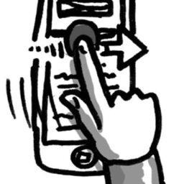

Examples of Accessibility
Mobile, Tablets, Web applications are made accessible to reach disable community (Universal and Inclusive Design)
The ridges found on the F and J buttons on a computer keyboard are designed to help users locate the correct keys (Universal and Inclusive Design)

Slide 5





Screen Readers
JAWS
Windows Eye
NVDA
Voice Over
Talkback

Slide 6

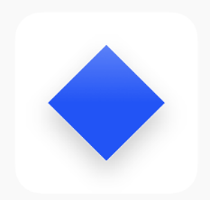




Open Source Plugins
WAVE
Color Contrast Analyser
Web Accessibility Toolbar
Google Light House
Acc Checker

Slide 7

Accessibility Compliance Law
Canadian Human Rights Act
AODA
European Union: EN 301 549:
ADA
US Section 508
UK-Equality Act
China – Law of Protection for PWD
India – National Policy for PWD
Singapore – Enabling Masterplan
Australia – Disability Discrimination Act

Slide 8
Case Studies of Accessibility
Tesco Access Site - 35 thousand pounds to build, 13 million pounds a year in resultant revenue (2004, UK)
Legal & General - achieved 50% more natural search visitors and many more conversions after accessibility improvements (2007, UK)
CNET - Reported 30% increase in CNET traffic from Google after they started providing transcripts. We saw a significant increase in SEO referrals when we launched an HTML version of our site, the major component of which was our transcripts. - Justin Eckhouse, CNET, 2009
Sydney Olympic Games - required to pay 20 thousand dollars in damages due to poor accessibility (2000, Australia)
Target Corporation - paid 6 million dollars in damages after action by US National Federation for the Blind (2008, USA)
Amex - America Express hit the headlines after excluding visually impaired customers due to making its statements less accessible in a format change (2008, UK)

Slide 9
Need for Compliance
WCAG Publish Timelines
1999 - WCAG 1.0
2008 - WCAG 2.0 (testable statements and were technology agnostic)
2012 - WCAG 2.0 became ISO standard, ISO/IEC 40500:2012
Eventually adopted across industry, government and many private organizations.
Need for WCAG 2.1
Technology is continuously evolving
Moved from brick mobile to touch screen smart phones.
New modalities - Gesture based, voice-controls, multi-touch interfaces.
WCAG 2.0 covers wide range of users with multiple disabilities, But the needs of users with low-vision and cognitive impairment weren't fully accommodated in WCAG 2.0.
June 2018 – WCAG 2.1
WCAG 2.1 new guideline and success criteria focus three major groups:
users with cognitive or learning disabilities,
Speech recognition
users with low vision,
users with disabilities on mobile devices

Slide 10
Conformance Level
There are three levels of conformance:
Level A: Must be satisfied otherwise one or more group will find access to content impossible. It’s the basic requirement.
Level AA: Should be satisfied otherwise one or more group will find access to content difficult. Removes significant barriers.
Level AAA: May be satisfied otherwise one or more group will find access to content somewhat difficult. Improves accessibility.
There are four accessibility principles in WCAG 2.1
There are a total of 12 Guidelines
Each Guideline has some Success Criteria that are at either level of conformance. Total 78 Success Criteria

Slide 11
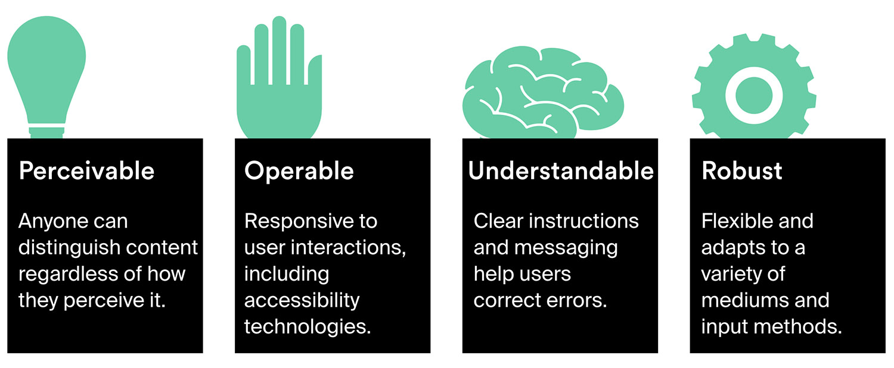
Accessibility Principles

Slide 12

Test Approach
Tool First
‘Tool First' used at the end of SDLC phase in assessment phase. Also called reactive approach. Accessibility testing happen at the end of the entire development cycle, if not after the delivery date.

Slide 13
Tool First Approach
Testing
Certify
Repair
Re-Test
Testing with Assistive Technologies like Wave/aXe, CCA, NVDA/JAWs, Screen Magnifier, Keyboard
Create consolidated defect sheet mentioning description, tool, success criteria breaking, defect id
Developer repairs or fix the accessibility defects And send back to developer for retesting
Retest or revalidate fixed defects using assistive technologies
Run regression tests covering key use cases
Run sample test cases related Disable User Testing
User Acceptance Testing
Conduct disabled user (people with low vision, blind, color blindness, , cognitive, motor) testing for usability issues with people with disability (PwD)
Incorporate observations and feedback shared by PwD users
Publish ‘Accessibility Statement’ on the website

Slide 14
Test Approach
Shift Left Approach
Shifting left allows for early detection of accessibility issues before they hit production and produces higher quality of accessible code, increases efficiency, reduces the costs of maintaining an accessible product.. Also called pro-active approach
Generally used at the start of SDLC phase when product idea is initiated. Included in design phase

Slide 15
Shift-Left Approach for new application
Create Accessible Content
Create Artifacts (Wireframes/User Journey) Accessible
Code
Test
Include accessibility standards while coding
Check with assistive technologies
Revalidate and close the defects
Conduct Disable User Testing
Test using assistive technologies
Certify and publish ‘Accessibility Statement’

Slide 16
Accessibility Implementation Life Cycle
Design
Code
Testing
Release
Small Investment
Small Investment
Small Investment
Large Investment
Implementing Accessibility
Implementing Accessibility
Shift Left Approach
Tool First Approach

Slide 17
References
https://www.google.com/image
https://en.wikipedia.org/wiki/Assistive_technology
https://www.deque.com/

Slide 18
Thank You!
For any queries connect me at jatinkochhar@hotmail.com

